Slide 1
SEAL 1.0
EST
2023

Slide 2
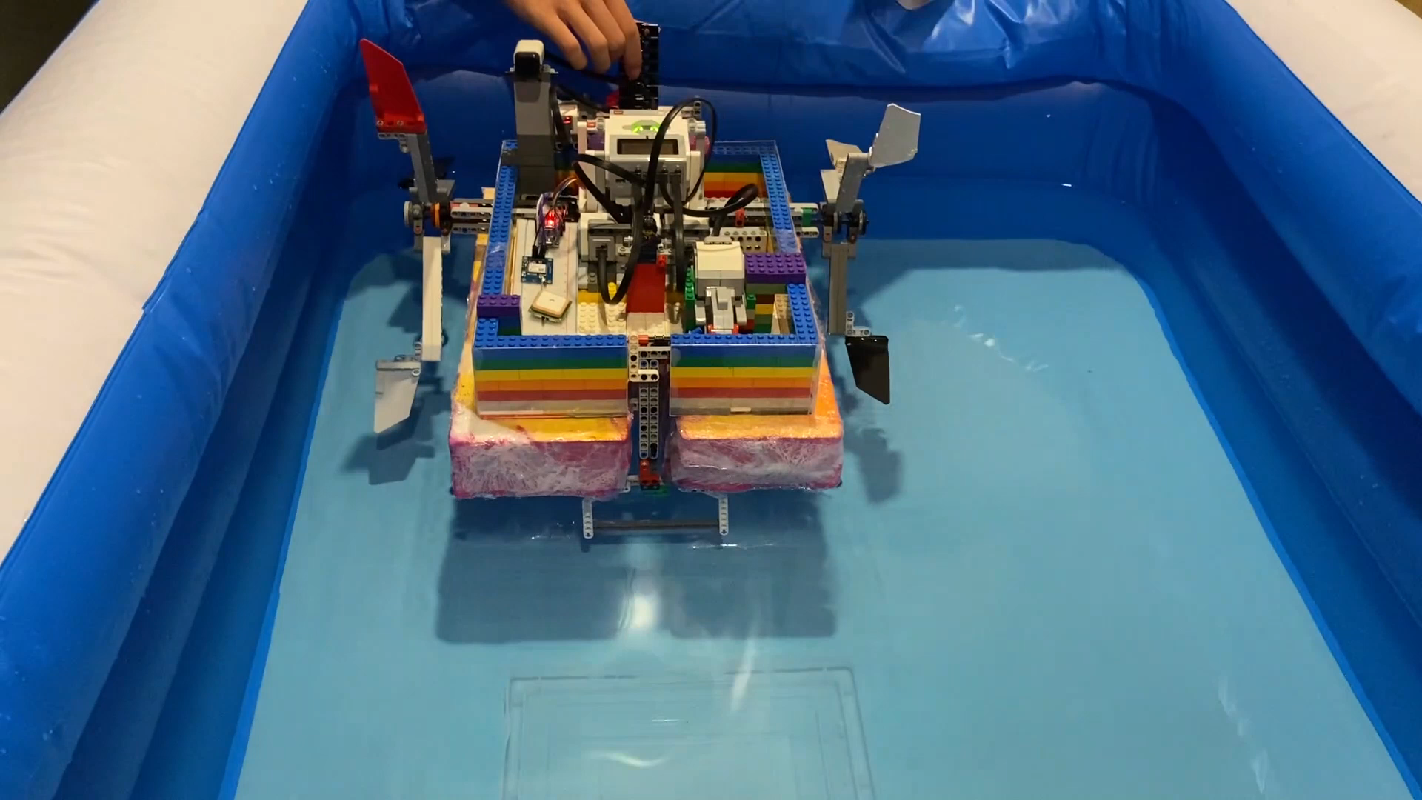

Slide 3
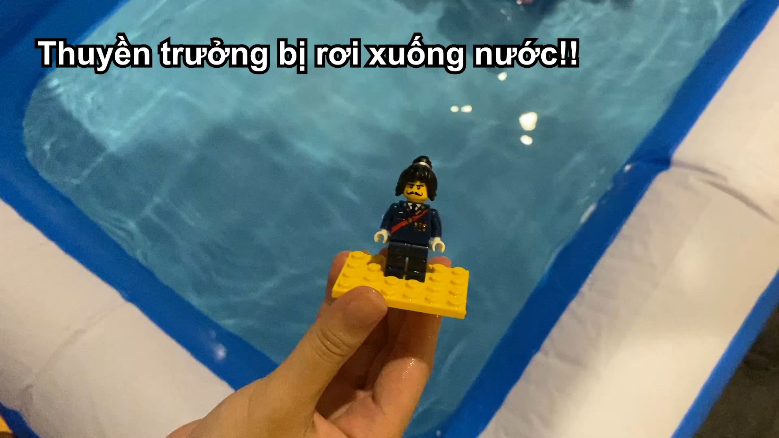

Slide 4
SEAL 1.0
EST
2023

Slide 5
THE END
Thăng Long’s Seal - A seal a day keeps the troubles away.

